Slide 1
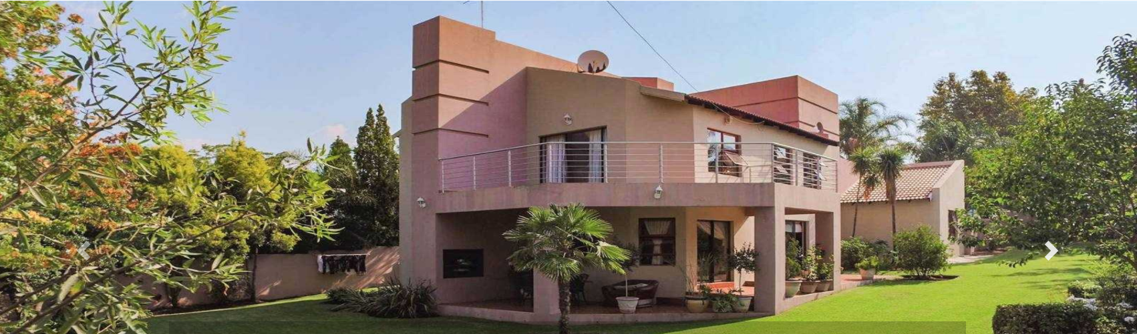
ESTATE MANAGEMENT SYSTEM

Slide 2
GROUP MEMBERS
S/N | NAME | REG NO
1 | KHALIL KABIR MUSA | UG18CSC2069
2 | MUHAMMAD JUNAIDU SANI | UG18CSC2068
3 | ALI MUSA BAFFA | UG18CSC2080
4 | IBRAHIM MUHAMMAD BAKO | UG18CSC2076
5 | SAGIR JIBRIN YAU | UG18CSC2098
6 | RUKAYYA SAYEED SAIF | UG17CSC1047
7 | SABIU IBRAHIM NASIDI | UG18CSC2070
8 | IBRAHIM ALI USMAN | UG18CSC2099
9 | YUSUF AHMAD ABDULLAHI | UG17CSC1003
10 | MARIYA TAHIR LAWAL | UG16CSC070
11 | UMMI GARBA | UG18CSC2072

Slide 3
CONTENT
ABSTRACT
INTRODUCTION
ADMIN MODULE
CUSTOMER MODULE
STATEMENT OF PROBLEM
AIM AND OBJECTIVES
USE CASES DIAGRAM
SEQUENCE DIAGRAM
CLASS DIAGRAM
CONCLUSION

Slide 4
ABSTRACT
Estate Management System is a web based application.
The biggest advantage of this estate management is, it provides online tool to communicate between property owner and the property buyer.
The software provide option for owner to put an advert, interested user can check out the advert and they can contact the owner for the purchase of the property.
It is very easy to search for the houses as the online offers are endless.
Our main aim is to give best & quick result to users.

Slide 5
STATEMENT OF THE PROBLEM
Keeping record in an estate concerning buildings and their owners has been a great task to the estate management.
Access to estate information proves difficult that most times people are defrauded due to lack of property information.
Illegal sales of houses without the consent of the owner are very common. Hence the need for computerization of estate management system.

Slide 6
AIMS AND OBJECTIVES
The aim of the project is to develop an online software application that will make the estate information available for individuals who may like to sell or buy property
The objective is to develop a software that will keep information on properties and handle the transactions details.

Slide 7
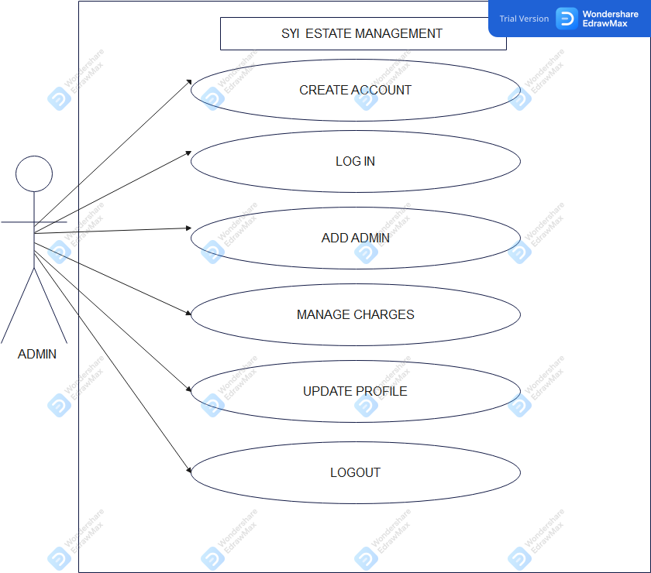
USE CASE DIAGRAM
Admin
Admin

Slide 8
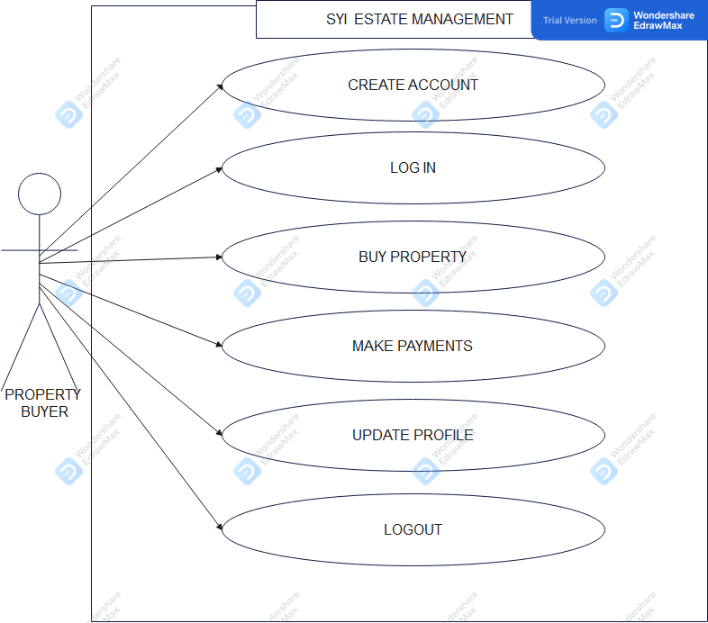
USE CASE DIAGRAM CONTD..
2. Property Buyer

Slide 9
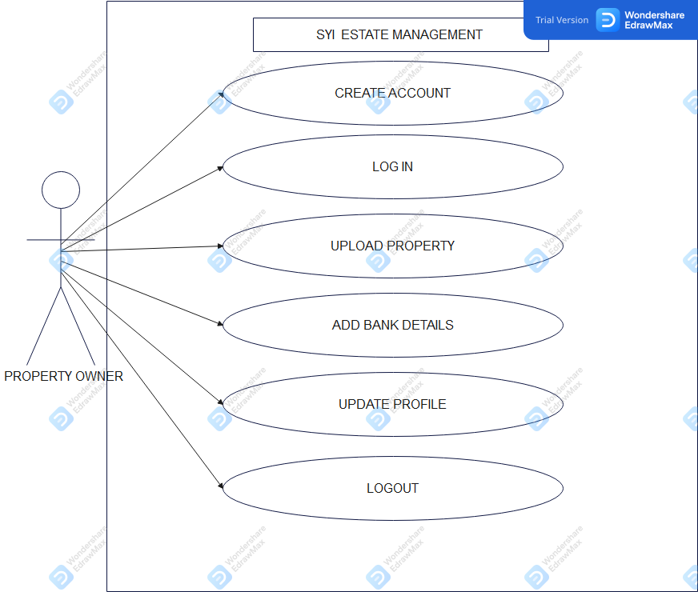
USE CASE DIAGRAM CONTD..
3.0 Property Owner

Slide 10
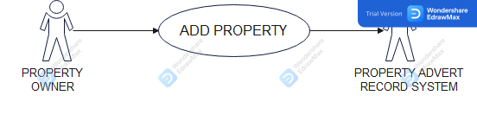
ADD PROPERTY USE CASE DIAGRAM

Slide 11
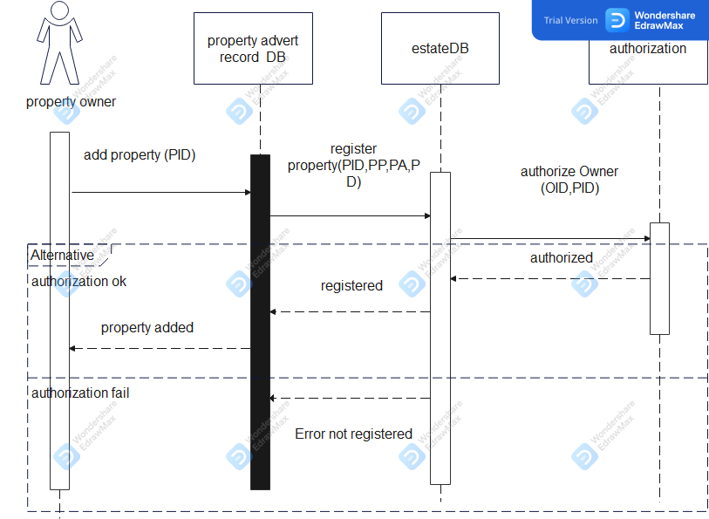
SEQUENCE DIAGRAM
Property owner

Slide 12
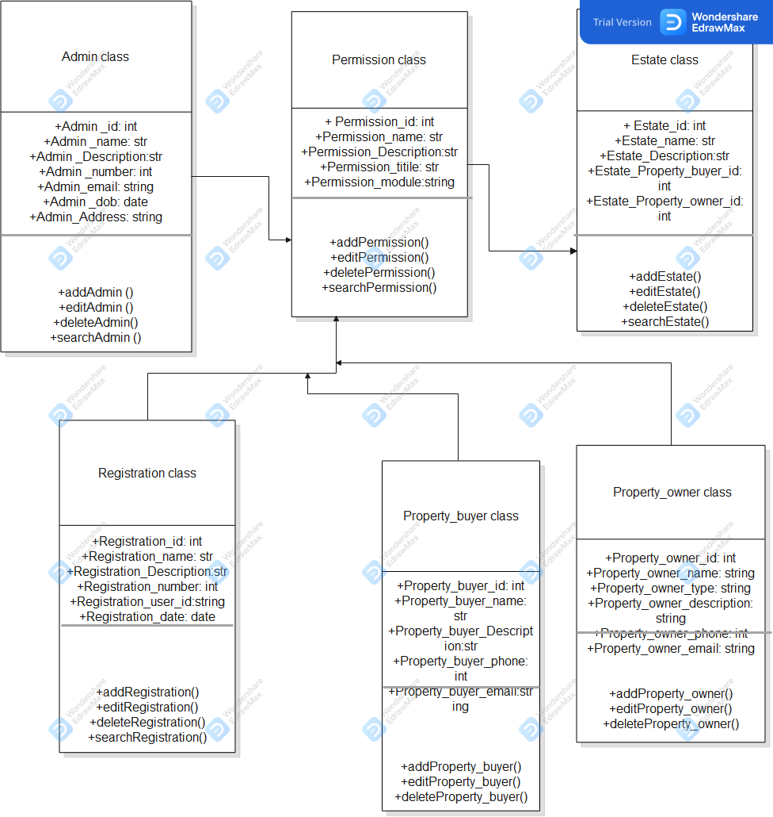
CLASS DIAGRAM

Slide 13
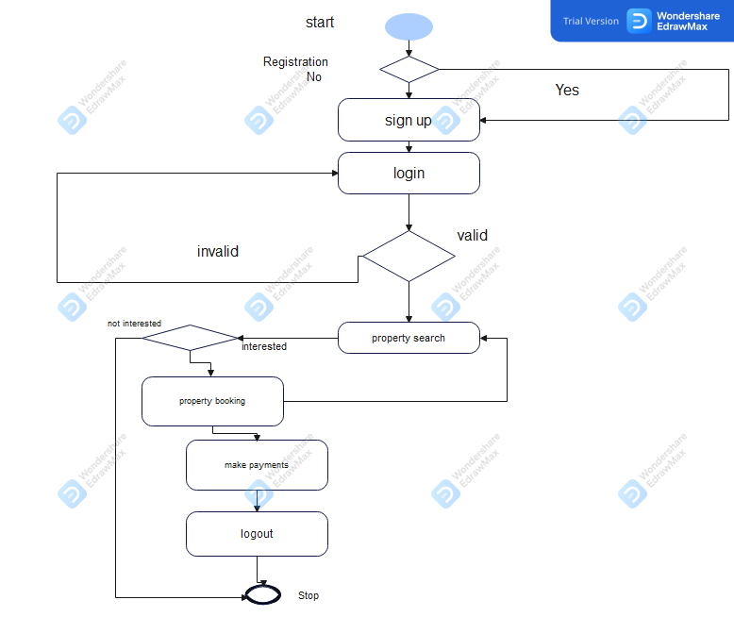
ACTIVITY DIAGRAM

Slide 14
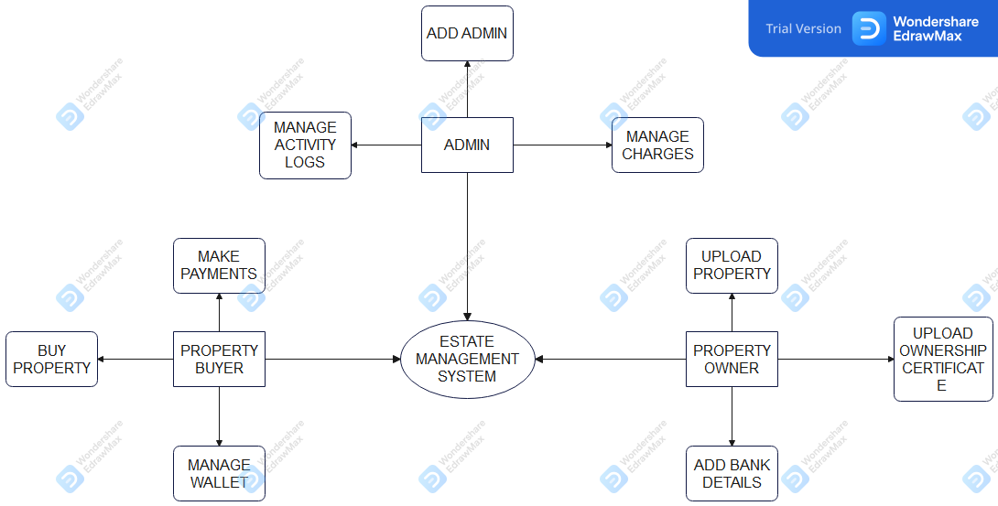
SYSTEM ARCHITECTURE

Slide 15
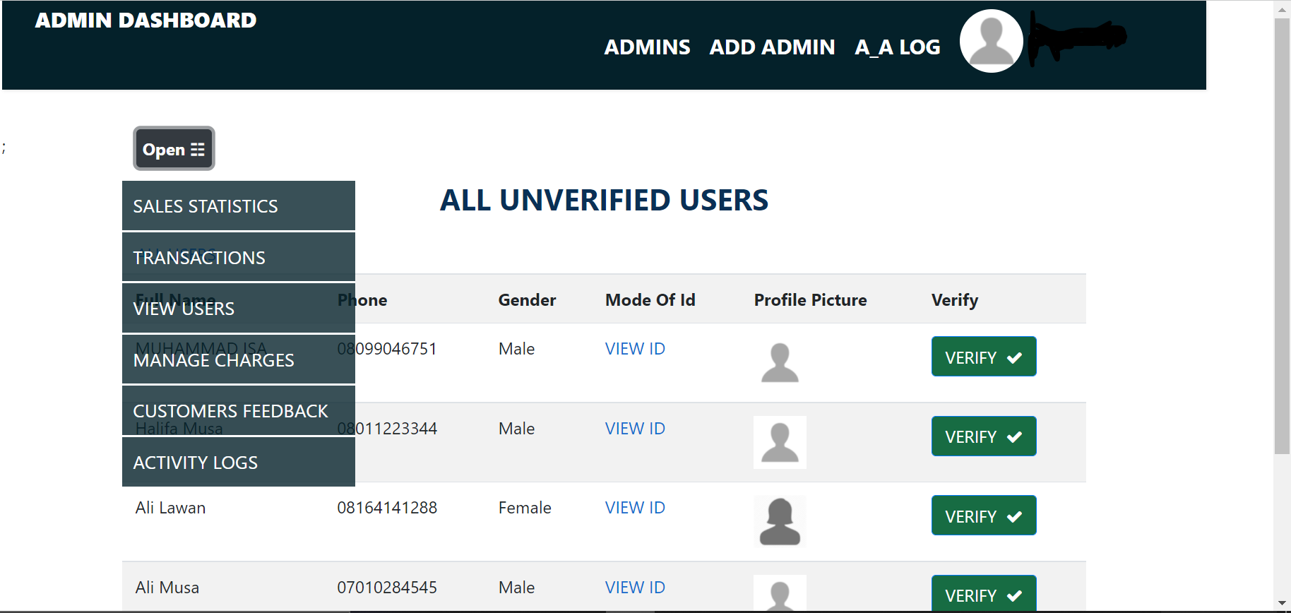
ADMIN INTERFACE

Slide 16
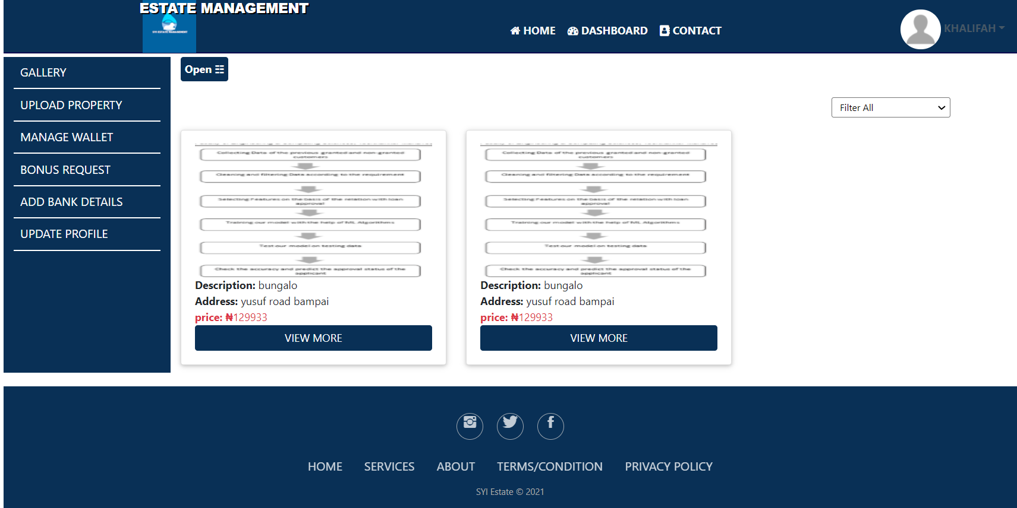
PROPERTY OWNER INTERFACE

Slide 17
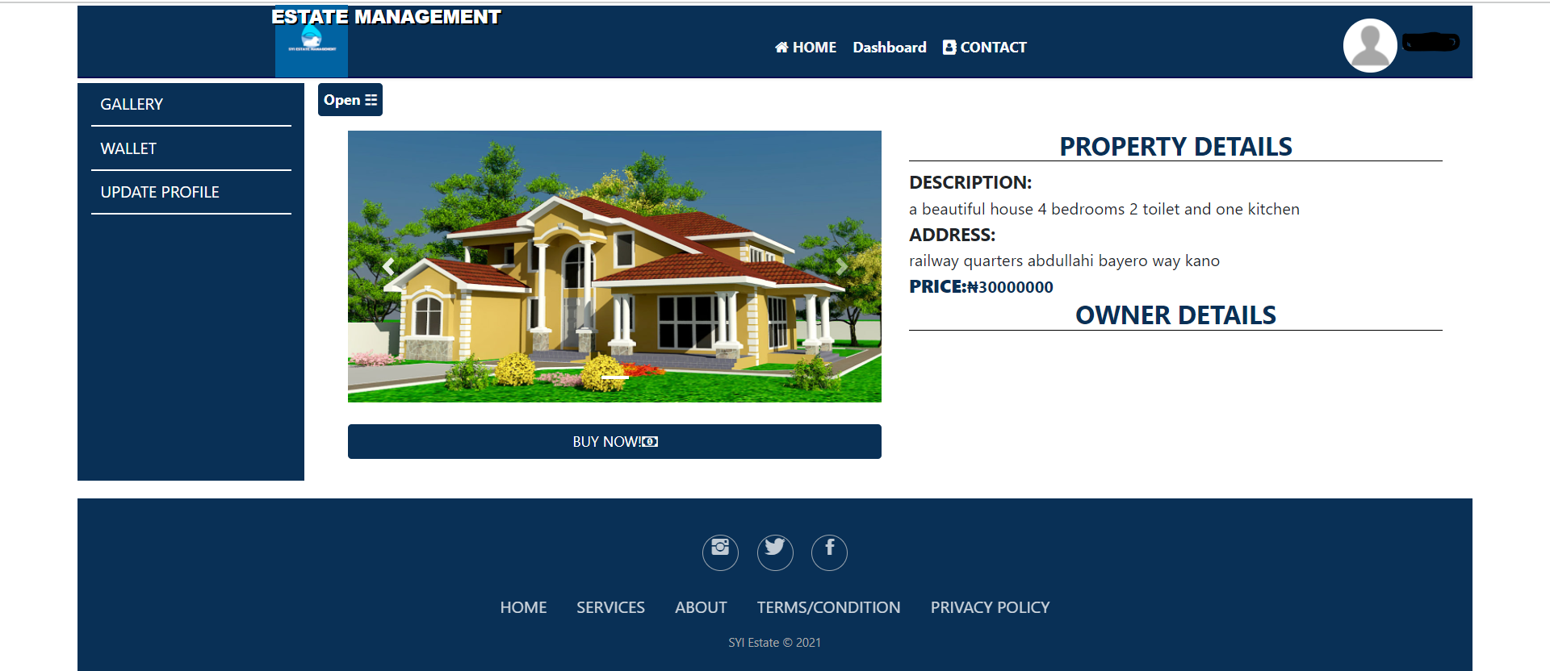
PROPERTY BUYER INTERFACE

Slide 18
CONCLUSION
Learning is never-ending process. Our work is just first steps to the particular approach of building of a system
This slides provided the summary of the introduction, background, problem statement, aim, objectives and some system design used in developing estate management system.

Slide 19
THANK YOU

